Slide 1
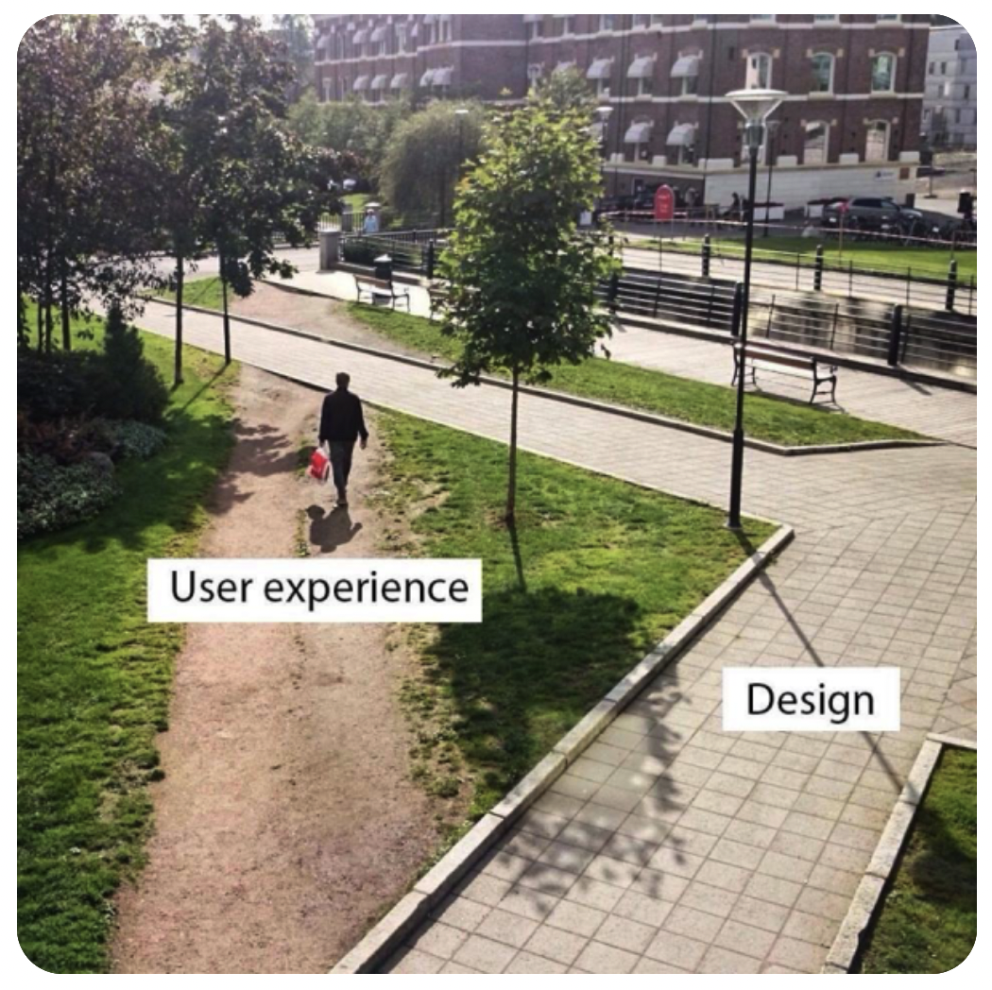
Understanding researcher
needs in TREs
Meag Doherty
Director, Research Experience
All of Us Research Program
Notes:
Big picture:
Introduction slide – Important here to mention that the All of Us Research Program is part of the National Institutes of Health. Please also mention your connection to the program, including if you are not officially affiliated with the consortium, but are a believer in the potential of the research program.
If possible, please include the particular research conference/event name and the presentation date.

Slide 2
All of Us Research Program Mission

Slide 3
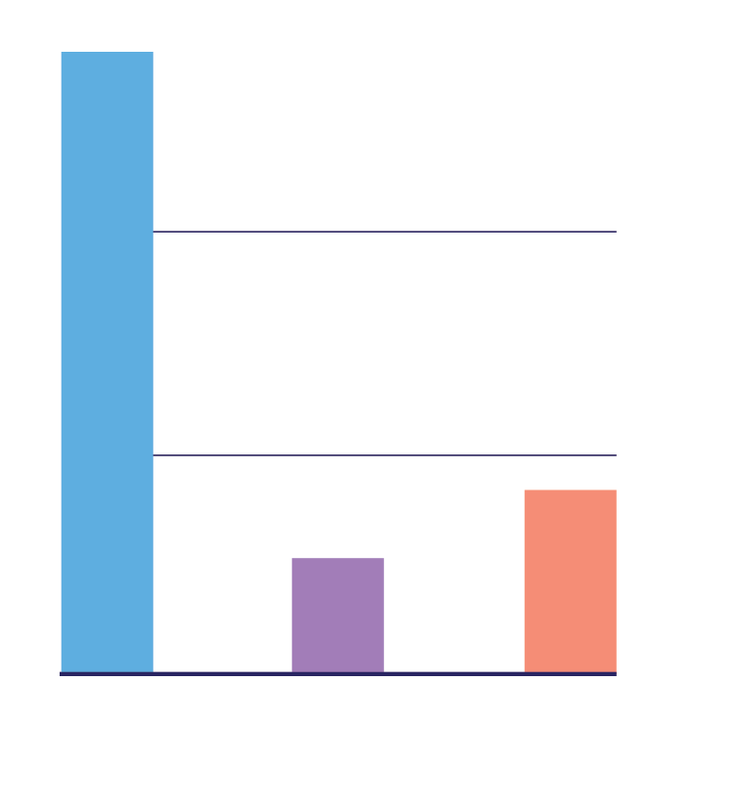
Research community to date
Our Researchers
260+
3,000+
400+
60+
50+
Registered
Researchers
Institutions
Academic
Institutions*
Non-Profit
Organizations
Health Care
Organizations
across a range of institutional roles
and career stages
*Includes 44 Historically Black Colleges and Universities and Hispanic-Serving Institutions.
Research Currently Underway
2,400+
65+
Top conditions
being studied
Active projects
As of 1 September 2022
Publications in
peer-reviewed
journals
In the Researcher
Workbench include:
Cardiovascular disease
Hypertension
Mental Health
Cancer
Diabetes
Notes:
Totals are accurate as of March 2022. Please confirm numbers and update as needed prior to presenting (See: All of Us Research, By the Numbers (https://docs.google.com/spreadsheets/d/1sk2P1TNgvyztMG8MYz2xWV_YOeYxo4mL3-UOICO-NpE/edit?usp=sharing)
1,500 + registered researchers
295+ institutions
204 academic institutions (including 36 HBCUs and Hispanic-serving institutions)
43 nonprofit organizations
44 health care organizations

Slide 4
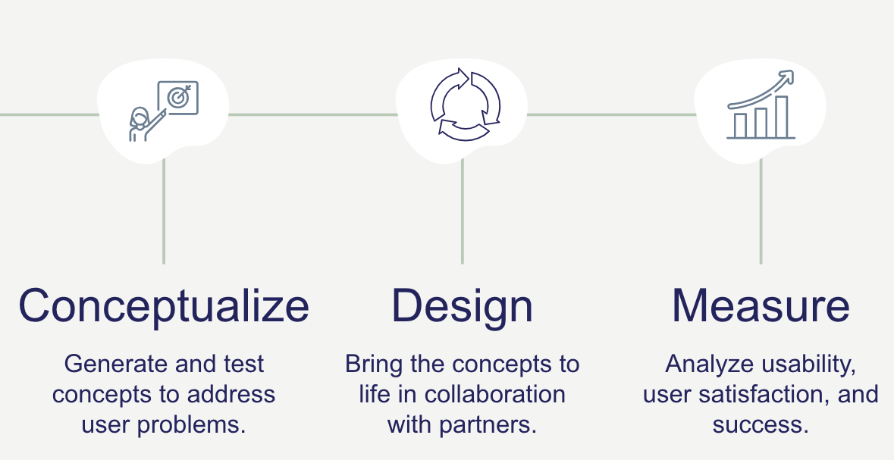
Addressing Researcher Needs
Within the All of Us Researcher Workbench,
a variety of materials inform and guide the use of our robust dataset
Customer Service (Help Desk)
1:1 support for research inquiries via Zendesk, Workbench access management,
bi-weekly office hours, and more
Education and Training
Knowledge base and community-based resources such as the User Support Hub, webinars, featured workspaces, video tutorials, instructional materials, and instructional materials.
Community Support Forum This dynamic “bulletin board” provides a place for researchers to pose questions to each other and support staff. Workbench users can read posts within the forum to benefit from lessons learned and form new collaborations.
Notes:
The Research support team is dedicated to making your experience with Phase 2 demonstration projects successful. To this end, we have provided multiple types of training materials, including tool user guides, instructional videos, data model tutorials, workspaces with example analyses and reusable code snippets. We also have a Help Desk to provide general and technical support, user forums and a searchable knowledge base.
User Support Hub
Tool user guides
Instructional videos
Data model tutorials
Knowledge base
Data Dictionary
PDF as part of detailed data documentation
Integrated directly within Workbench tools
Researcher Workbench
Featured Workspaces (e.g., example analyses, Phenotype Library)
Reusable “code snippets”
Demonstration projects
Help tips
Help Desk Forms
Specialized forms
Ask a question or get help
Feedback
Publication
Billing credits
Privacy concerns

Slide 5
Thank You!
ResearchAllofUs.org
AllofUs.nih.gov
@AllofUsResearch
#JoinAllofUs
Notes:
NOTE
Do not use the outdated All of Us logo with the "Precision Medicine Initiative” tagline/slogan.
Preferred website links can be ResearchAllofUs.org (includes the Data Browser) and JoinAllofUs.org

