Slide 1
Data Safe Haven project
Photo by Michael Dziedzic on Unsplash
RSECon2022 Trusted Research Environments
5th September 2022
James Robinson
Senior Research Software Engineer
jrobinson@turing.ac.uk

Slide 2
What is the Turing Data Safe Haven?

Slide 3
Framework for agreeing data sensitivity
Software-defined reproducible deployment to Azure cloud
Isolated secure research environment (SRE) per-project
Easy to deploy or tear down as needed
Not service offered by Turing: code for building your own

Slide 4
Architecture Overview

Slide 8
Using the Turing Data Safe Haven

Slide 9
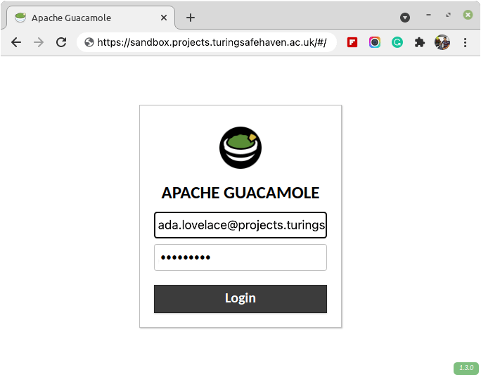
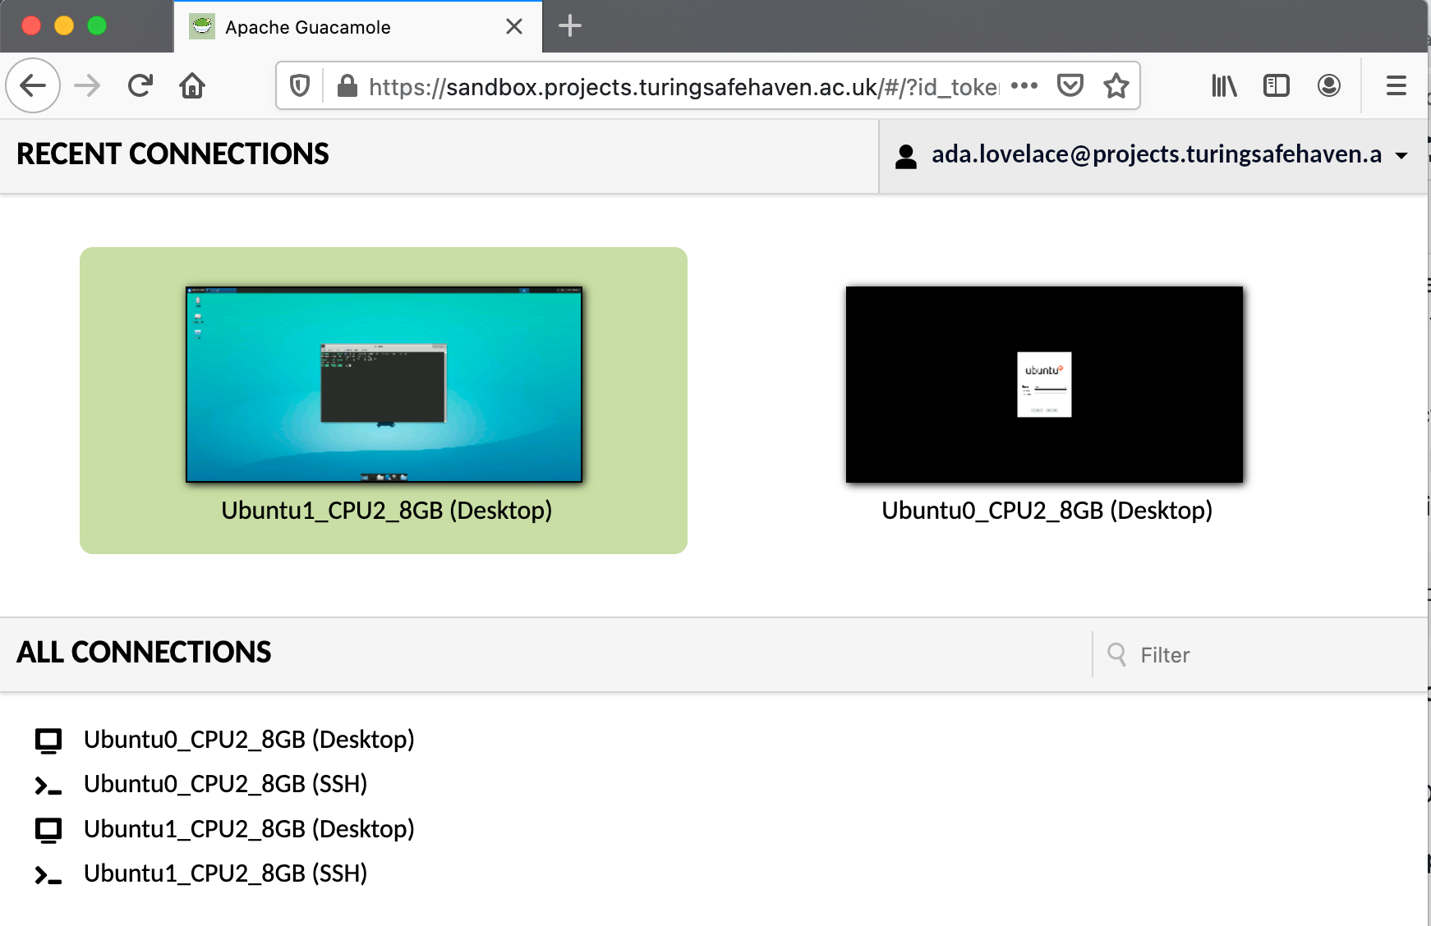
In-browser remote desktop
Connect using password, MFA, known IP address
No internet access from the SRE
No copy and paste between the SRE and the user’s computer
Data cannot be accessed except through the SRE

Slide 10
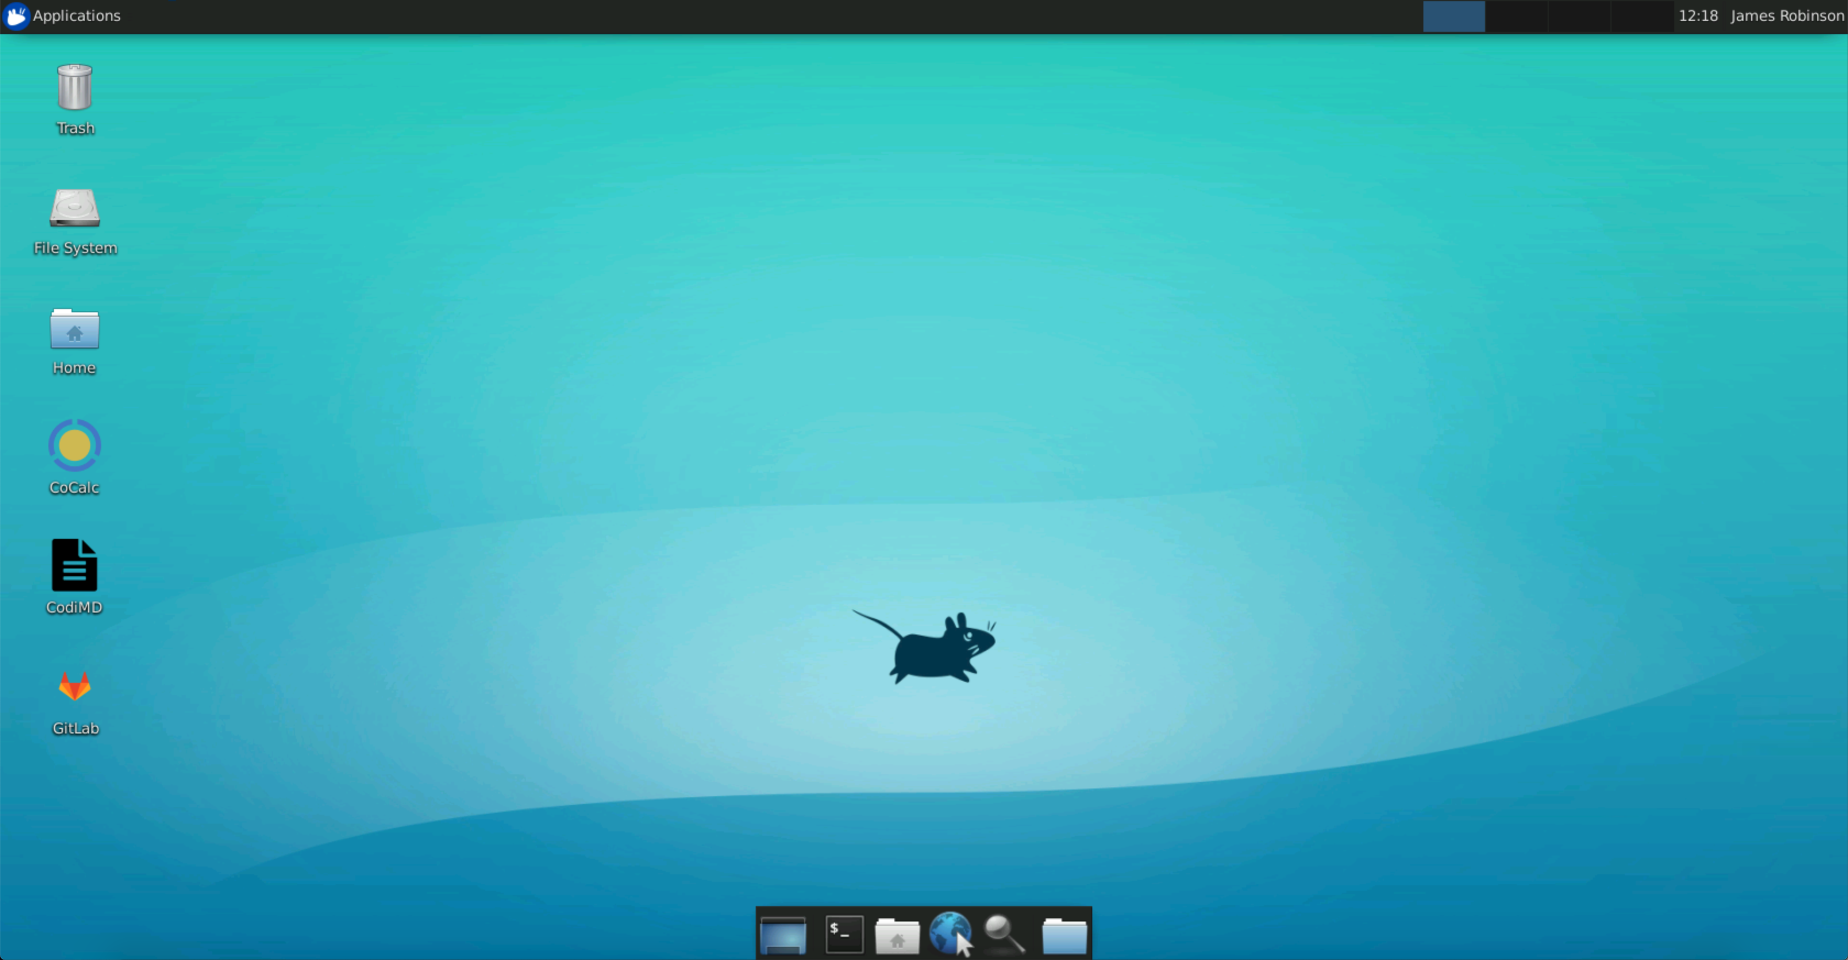
Wide range of data science tools pre-installed to support offline work
Offline copies of Python and R package repositories
Ability to install additional software as agreed by project

Slide 11
Data transfer
Secure transfer from data provider to the Safe Haven (via Azure storage)
All stakeholders must approve any transfer of data/code/results in or out
Security
Regular external penetration tests of latest release to confirm security
Cleanup
Data and code are deleted when SRE is torn down at the end of the project
Scale and focus
Developed over past 4-5 years to meet internal demands
Turing typically supports 5-10 researcher-led teams at any one time

Slide 12
What are our future plans?

Slide 13
Certification
NHS DSPT submission in progress
Longer term Cyber Essentials Plus and ISO 27001
System improvements
Make it easier for system administrators to inspect a running Safe Haven
Data enters system at discrete points in time – changes needed for continuous flow
Make the project public
Should be later this week (waiting for sign-off from legal team)
Collaboration
Looking for active collaborators to work together on a common, public codebase

Slide 14
Slack: general discussion/debugging/help
https://bit.ly/3C4js56 [turingdatasafehaven.slack.com]
GitHub: code base
https://github.com/alan-turing-institute/data-safe-haven
Email: for contacting us directly
safehavendevs@turing.ac.uk [developers]
Newsletter: new releases and announcements
https://tinyletter.com/turingdatasafehaven

Slide 16
Backup

Slide 17
Tier 3
Tier 2
Tier 1
Tier 0
Tier 4
Tier 0 environments are used to handle, combine or generate:
publicly available, open information
data which is intended for immediate publication

Slide 18
Tier 4
Tier 3
Tier 2
Tier 1
Tier 0
Tier 1 environments are used to handle, combine or generate:
data intended for eventual publication
datasets where the only risk of disclosure is to the researchers’ competitive advantage
pseudonymised or synthetic personal data where confidence in the quality of deidentification is absolute
commercial information where the consequences of unauthorised disclosure are so low as to be trivial

Slide 19
Tier 4
Tier 3
Tier 2
Tier 1
Tier 0
Tier 2 environments are used to handle, combine or generate:
pseudonymised or synthetic personal data where confidence in the quality of deidentification is strong
commercial or legal data where risks from disclosure are low

Slide 20
Tier 4
Tier 3
Tier 2
Tier 1
Tier 0
Tier 3 environments are used to handle, combine or generate:
most non-pseudonymised personal data
pseudonymised or synthetic data where confidence in the quality of deidentification is weak
commercial or governmental data that is sensitive or likely to be subject to attack by attackers with bounded capabilities

Slide 21
Tier 4
Tier 3
Tier 2
Tier 1
Tier 0
Tier 4 environments are used to handle, combine or generate:
personal data where disclosure poses a substantial threat to personal safety, security or health
commercial or governmental data which is likely to be subject to attack by sophisticated, well-resourced and determined actors (e.g. nation states)

Slide 22
Mapping to other systems
Our classification process originally focused on research projects
Not always possible to map our classification tiers to other systems on one-to-one basis
Some approximate mappings are laid out below
UK government classification
Official → Tier 1 or Tier 2
Official Sensitive → Tier 2 or Tier 3
Secret / Top Secret → Tier 4
NHS classifications
Public → Tier 0 or Tier 1
Protect → Tier 2 or Tier 3
Confidential→ Tier 3 or Tier 4

Slide 23
Work packages
Independent per-project Secure Research Environments (SREs)
Shared Safe Haven Management
Package mirrors for Python + R
WP1
WP3
Per-project Tier 3 Mirrors
Per-project whitelist
WP2
Internal
External
PyPI / CRAN
DPR
Shared Tier 3 Mirrors
Global whitelist
Data Ingress
Project specific SRE
INV
Data
Internal
External
PyPI / CRAN
REF
Shared Tier 2 Mirrors
Mirror all packages
CPU
GPU
Internal
External
PyPI / CRAN
DPR
INV
REF
Cluster
Data Egress
Authentication
User
Per-project access controls
Remote Desktop
GitLab
CodiMD
Shared services
Users + Groups
MFA
User

Slide 24
Case Study: Data Study Groups
Challenge owners
Government: eg. DSTL, The National Archives, British Antarctic Survey, Ofsted
Industry: eg. catsAi, Greenvest Solutions, Telus, Siemens, Airbus
Third sector: eg. WWF, Cochrane, Amnesty International
Benefits
Challenge owners: quickly prototype possible solutions to data science challenges
Researchers: put knowledge into practice solving real-world problems

